Slide 1
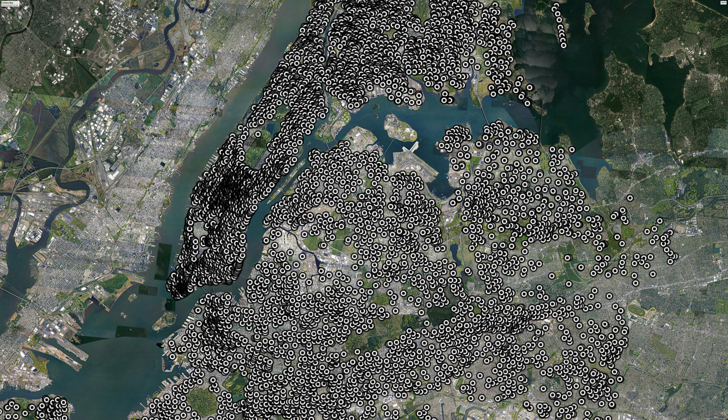


Can You Hear
Me Now?
Telecommunications
Strategies for 2020 and Beyond
By Shantell Richardson

Slide 2



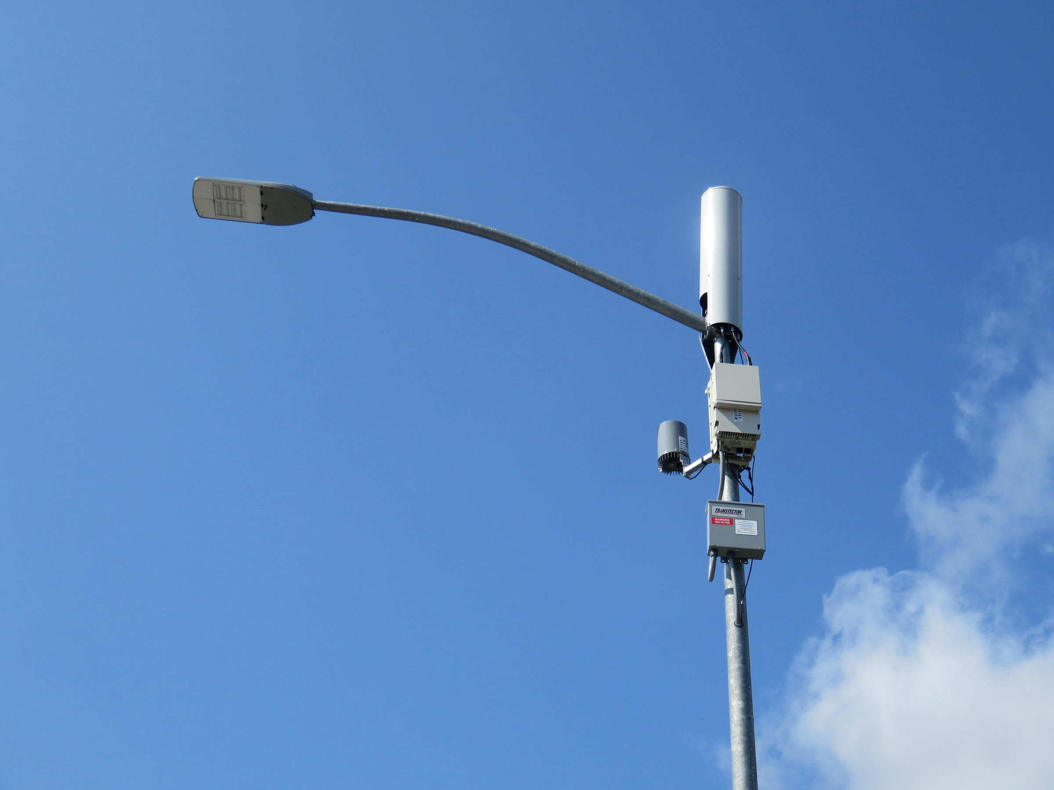

It's Just a Pole
SMALL BUT MIGHTY
CELL LOCATION
These poles sites are key players in enabling 5G low-power antennas known as small cells and DAS (distributed antenna systems).
Population Density
Proximity to Fiber Optic Lines
Height and Line of Sight
Ramsay Richardson
Project Manager
Synergy Technologies
15+ years experience managing telecommunications construction projects for major carriers as well as key mobile telecommunications franchises.
DAS systems allow them to support more than one service provider
Notes:
hello

Slide 3
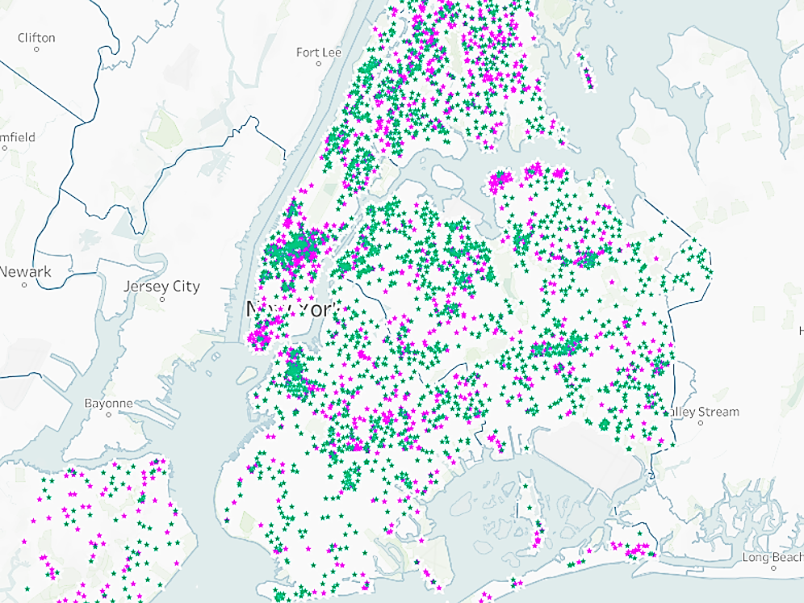
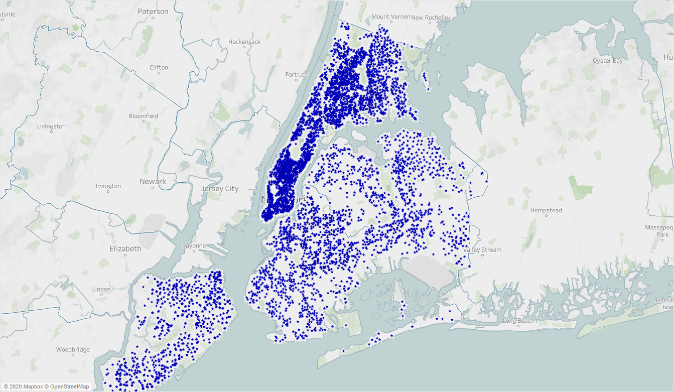
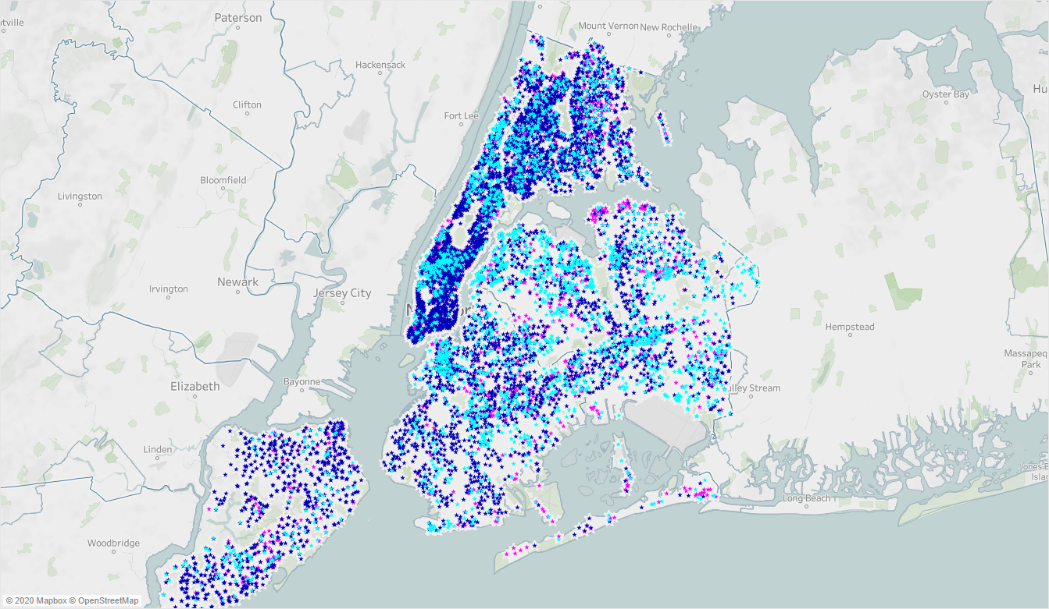




Installed
Pole Locals
Approved
&
Proposed
Pole Locals
4
The Dataset
Franchises
which lease pole space to major mobile carriers
198
Neighborhoods
across the 5 boroughs
9,282
Locations of street lights, traffic lights and utility poles authorized by the NYC Dept. of Information Technology and Telecommunications for the installation of mobile telecommunications equipment.
Notes:
gflhqghqhghPGHH

Slide 4
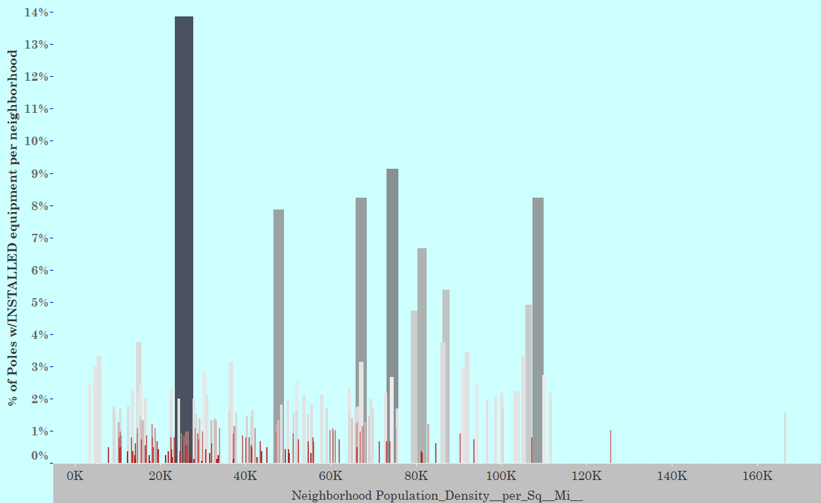
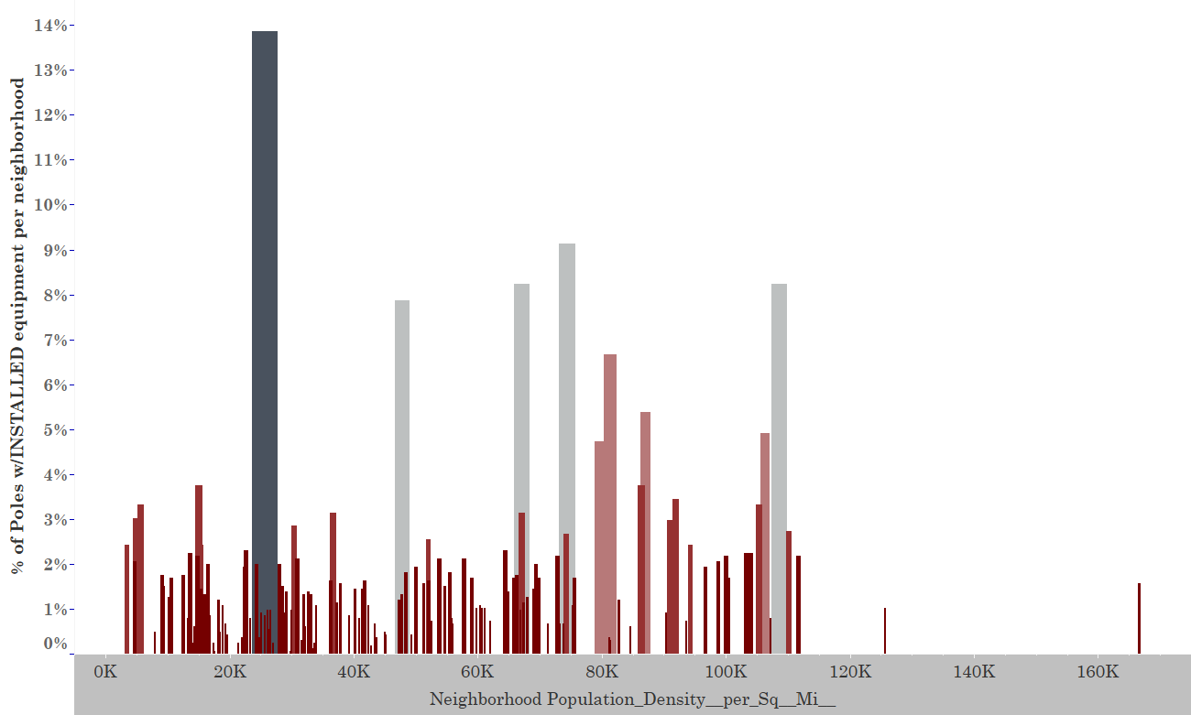

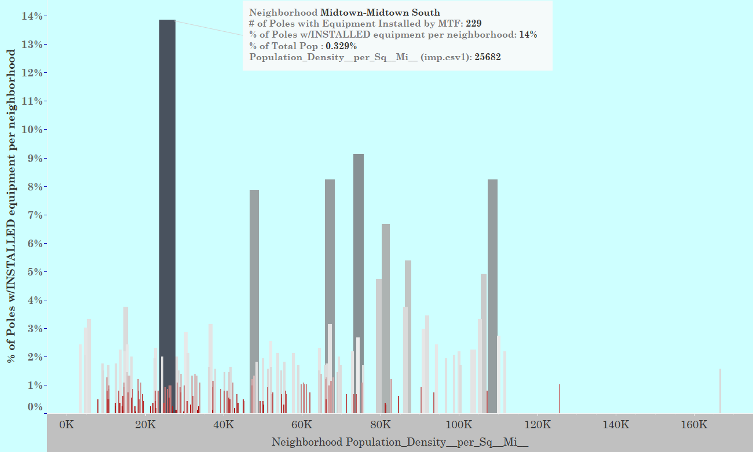
Review of Current Franchise Market Strategy
Poles with equipment INSTALLED in relation to Neighborhood Pop Density

Slide 5



THE SHIFT
COVID ARRIVED
HOW DO WE MEET THIS CHALLENGE?
This epidemic has forced individuals and companies alike to restructure pathways to success pertaining to every facet of life
INCREASED DEPENDENCY ON OUR DEVICES
Meet the people where they are.
We must pivot to amplify the service to residential clusters.
phones, laptops = the new workplace
allowing us the freedom to work remotely. With dropped calls and spotty reception, the strain on these resources shows

Slide 6
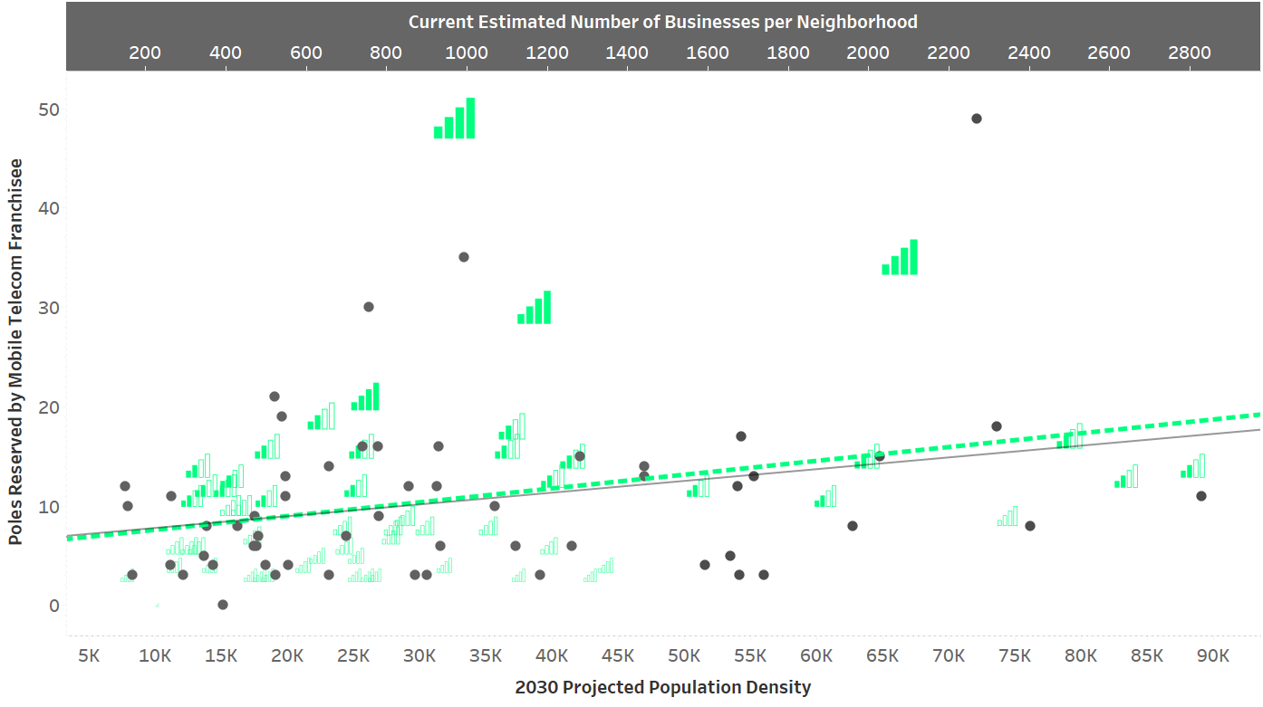
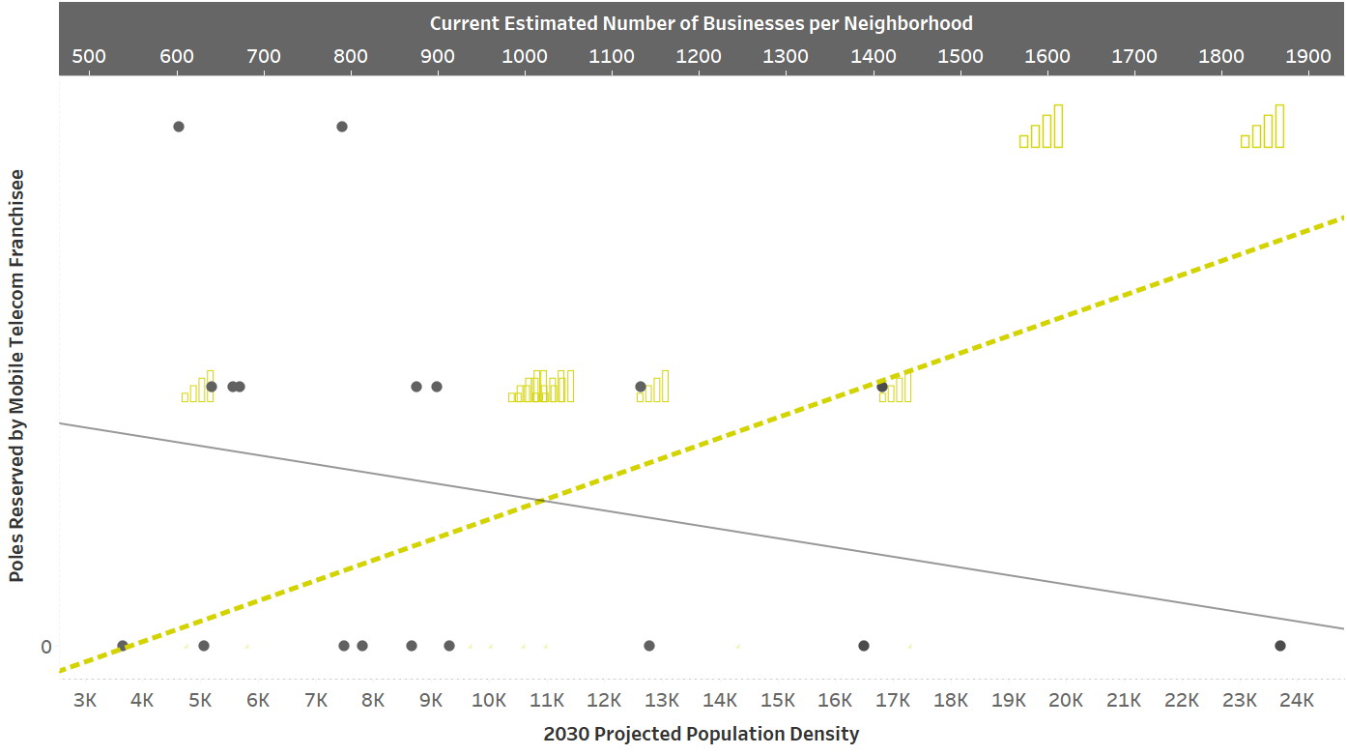
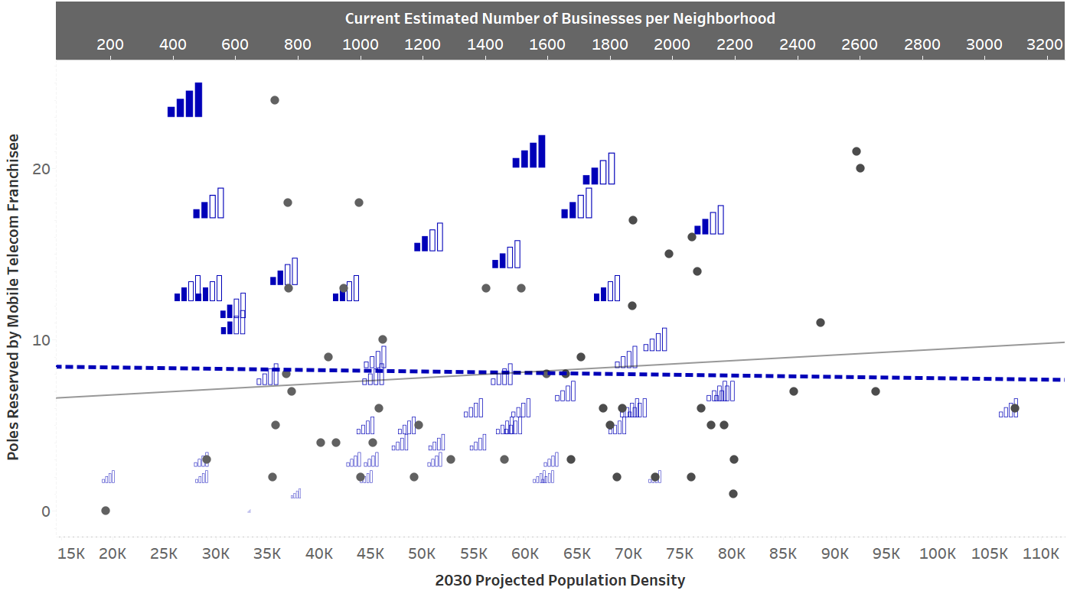
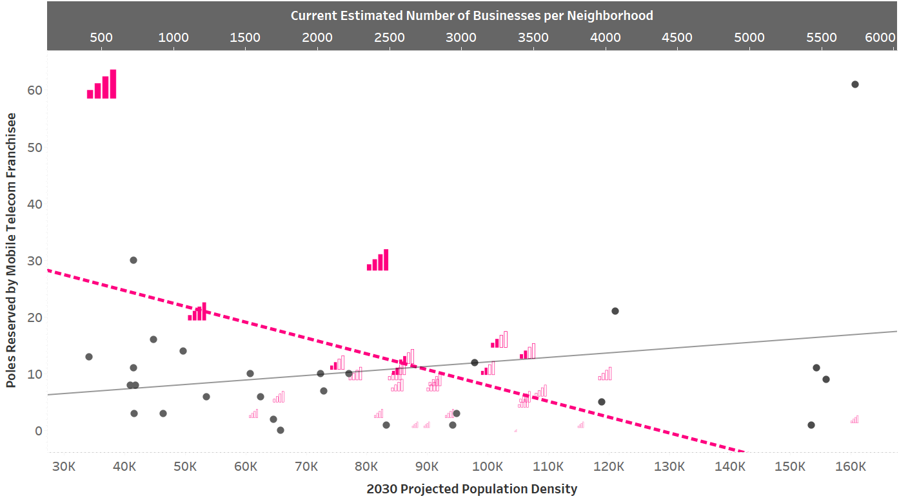
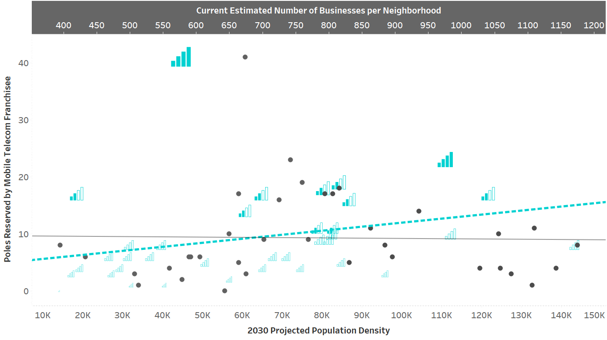
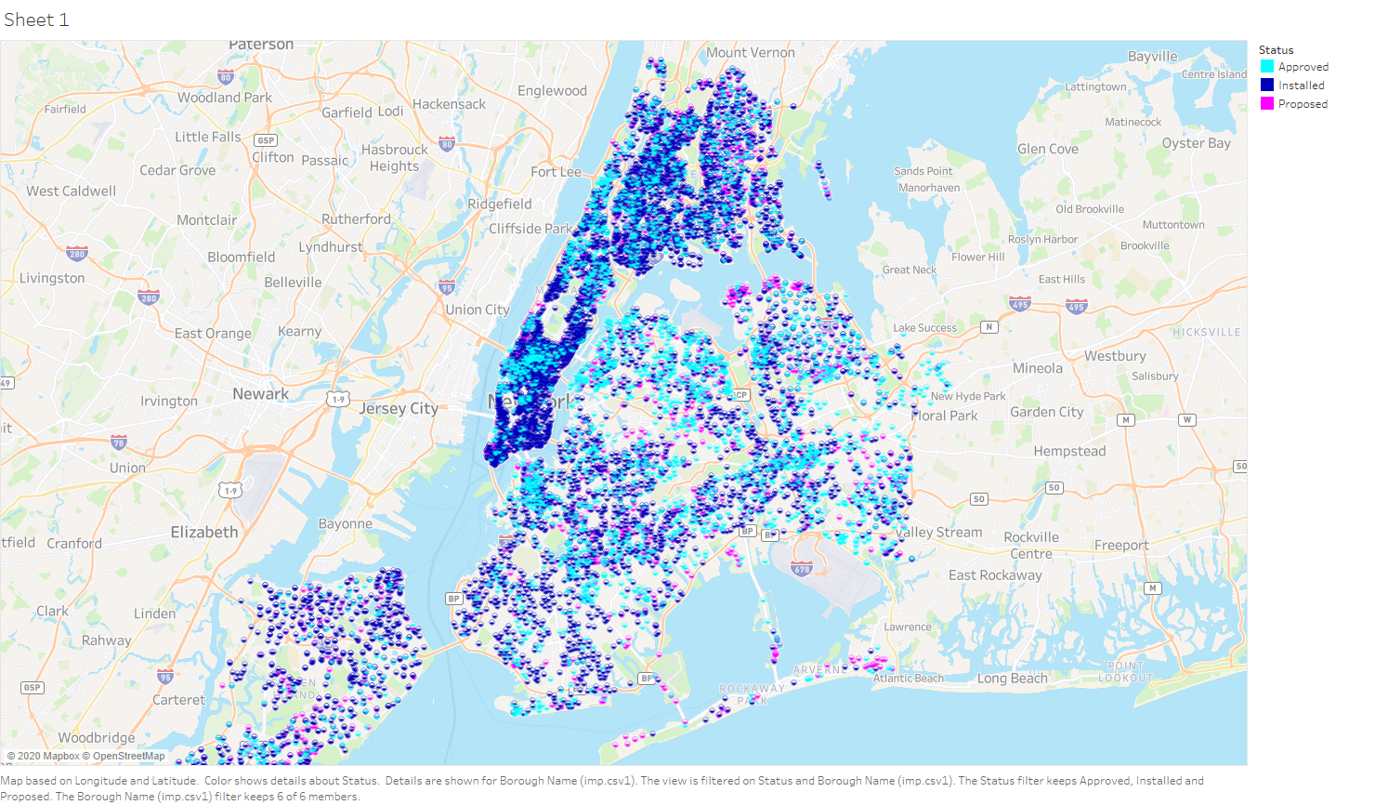
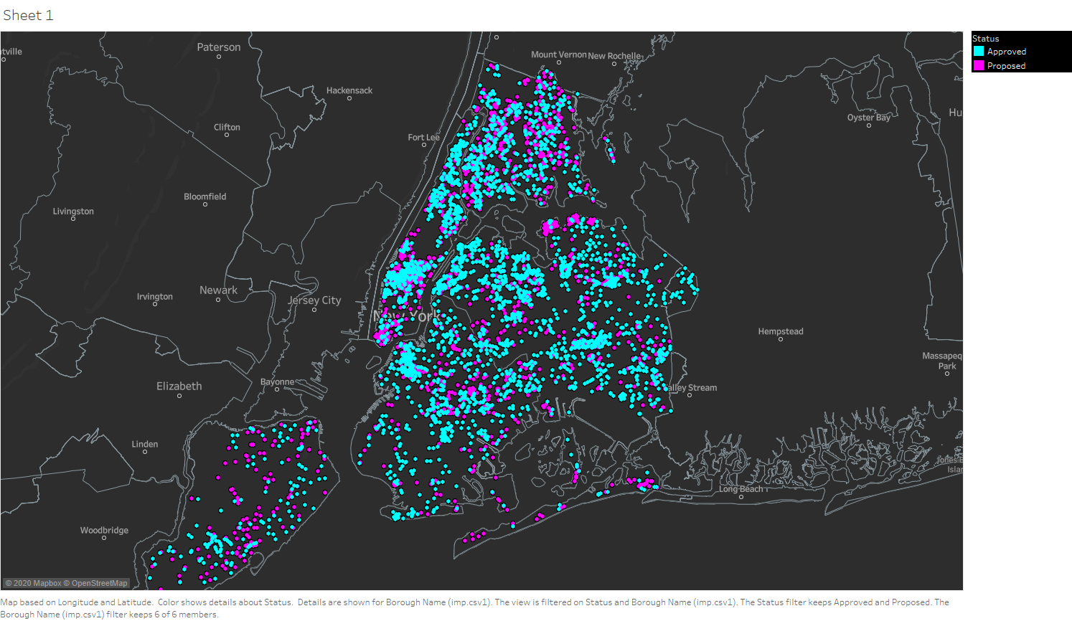
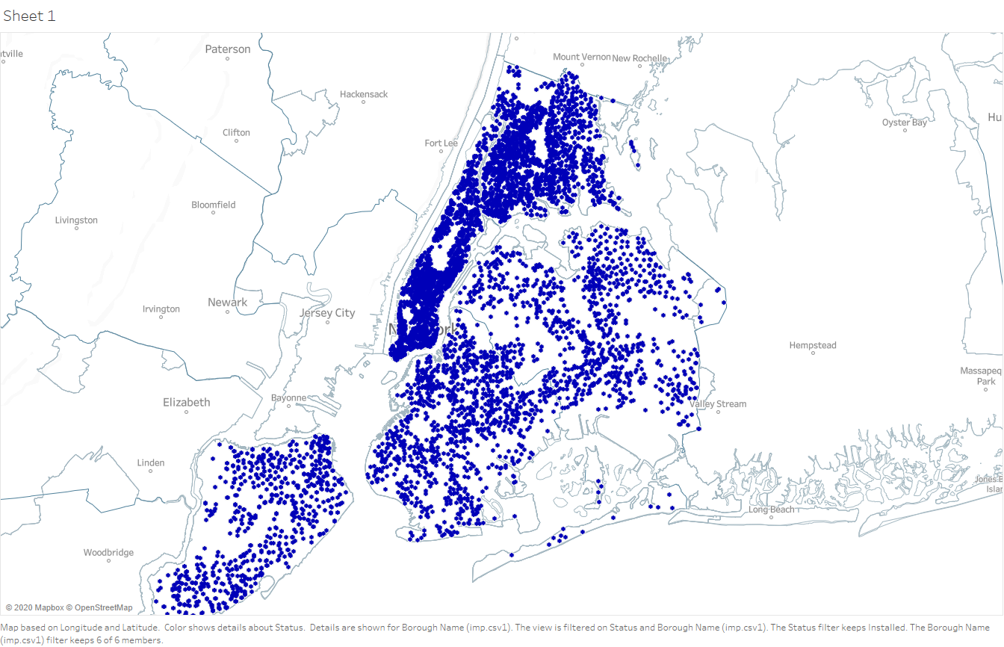
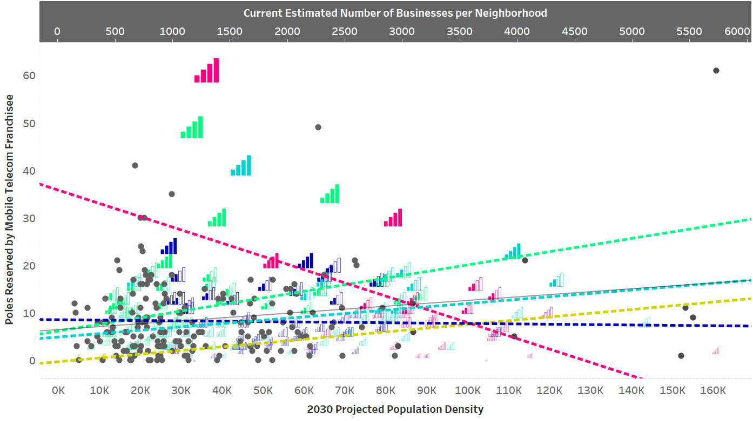
Boroughs that follow the residential cluster model:
Queens
Staten Island
Queens
Boroughs that must pivot to serve residential areas:
Manhattan
Brooklyn and
The Bronx
Manhattan
The Bronx
Staten Island
Brooklyn
Dot = CURRENT pole selection strategy (business clustered)
Wifi signal = FUTURE pole selection strategy (population clustered)

Slide 7
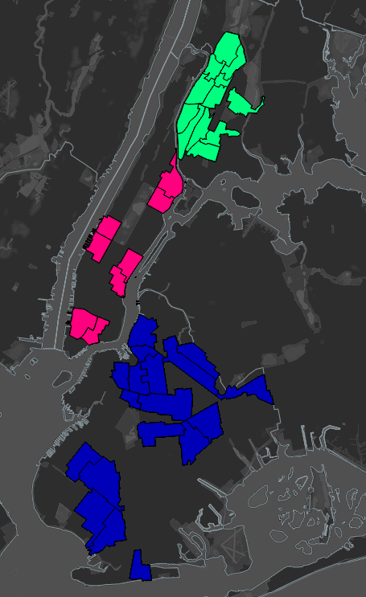
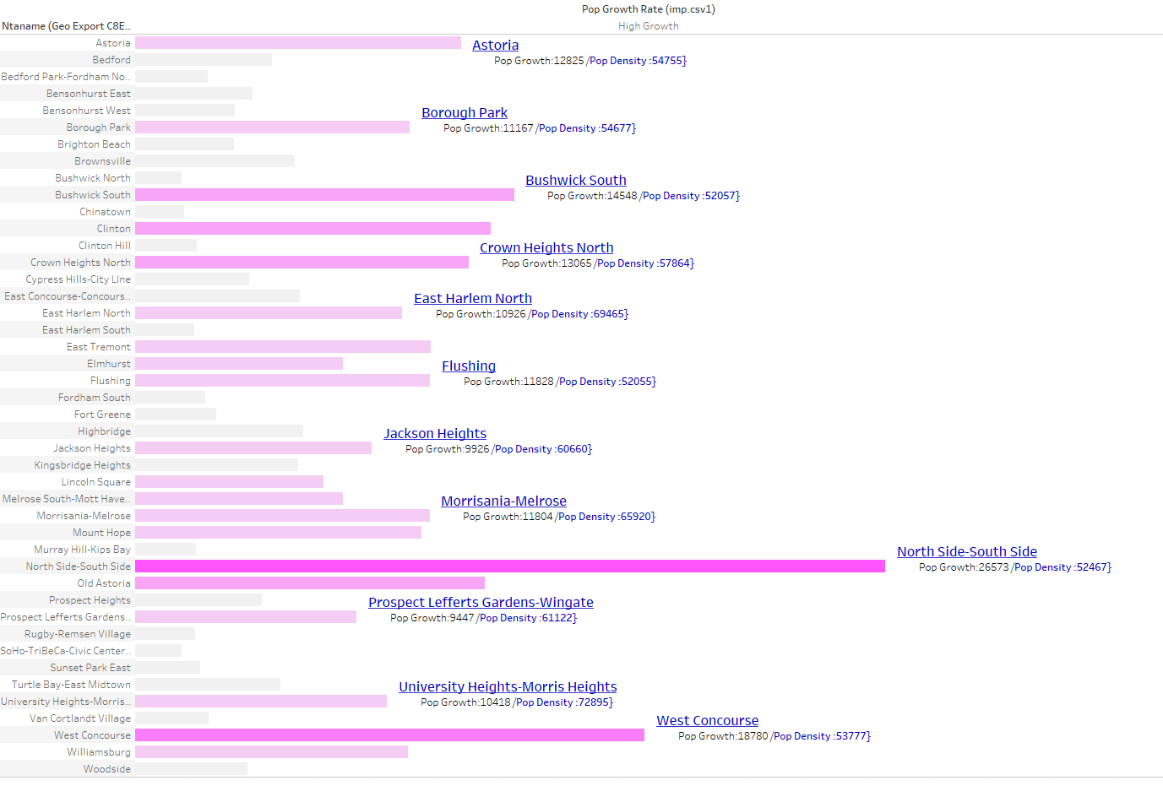
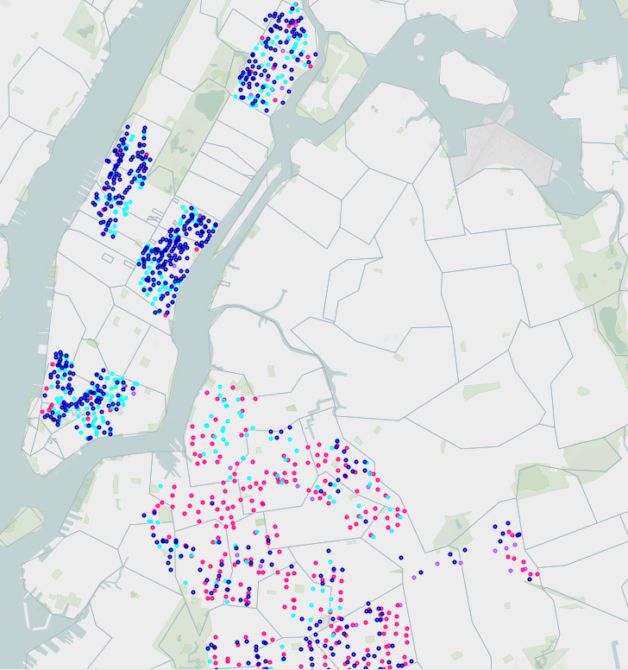
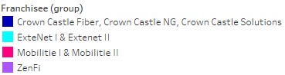
High Growth Neighborhoods identified as areas that increase in population by
3622+ residents in the year 2030
The Bronx
Manhattan
Brooklyn

Slide 8
Additional feature engineering and model development to identify KPI’s
Re-run my study and model with updated numbers adjusted for “post-Covid flight.”
Include RF Maps for greater signal strength accuracy, so as to make key recommendations for carriers to reach sustainability and inclusion goals for the “Connect 2030” summit hosted by the International Telecommunication Union (ITU)
Further steps

Slide 9

Let’s Connect!
https://github.com/Sricha02/FINAL_CAP
https://www.linkedin.com/in/shantellrichardson/
Shantell.Richardson@gmail.com
Notes:
gflhqghqhghPGHH

Slide 10
